Slide 1
Connecting the Dots (Feudal System to Columbus)
Jarred Holland P.3

Slide 2
Introductory Paragraph
“Exploration is the engine that drives innovation. Innovation drives economic growth. so let’s go exploring”- Edith Widder. That quote by Edith Widder is what has driven so many people to explore throughout history, such as Christopher Columbus. However, if Christopher Columbus had been born even 600 years earlier, he wouldn’t have even thought of exploring past his own house. Certain things had to be in place in order for him to succeed. He needed the right teaching, tools, and environment to go. The only way for those to be there is that a series of events would have to happen, each connecting themselves to each other in ways no one would have guessed. In order for Columbus to have been able to travel to the New World, dots throughout history had to be connected, one at a time.

Slide 3
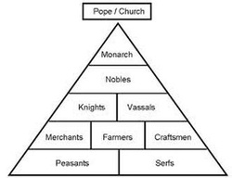
Feudal System
P. E. R. S.
-The Feudal System ran Europe from 500-1500 AD
-It was a sort of hierarchy, based on the Catholic Faith.
-The Pope, the leader of the Catholic Church, had complete power over Europe; everyone listened and nobody questioned his words
-Kings remained loyal to the church, as well as ruling over lands about the size of countries called estates
-Knights were loyal to their king for land and their social status
-Peasants, or serfs, were loyal to their Knights in return for protection.
-90% of all the European population were serfs
-Some Kings had Barons, who served the King, but had Knights serve them for land they had got from the King. (OI)
-

Slide 4
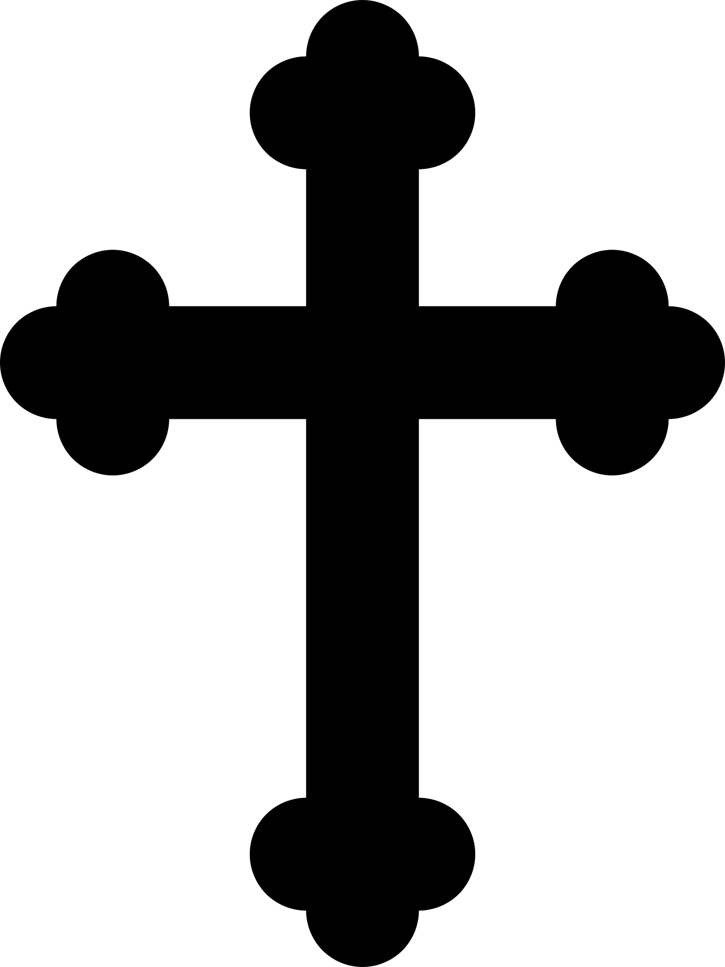
Feudal System (Historical Significance/Predestination)
P. E.R.S.
-The historical significance of the feudal system is that it ruled over Europe for 1,000 years and no advancements, in thought or in science, were made. The reason this horrible system stayed in place was because everyone believed in Predestination. Predestination was a belief that you were put on this earth to suffer. and your payment for suffering was that when you die, you live in paradise for eternity. Because everyone believed in this, nobody questioned their own life or tried to improve it, they just lived on with their terrible life. For example, (OI) the average lifespan of a serf was 35. However, there was a very small chance of making it to 21, but if you did, you lived about 50 more years.

Slide 5
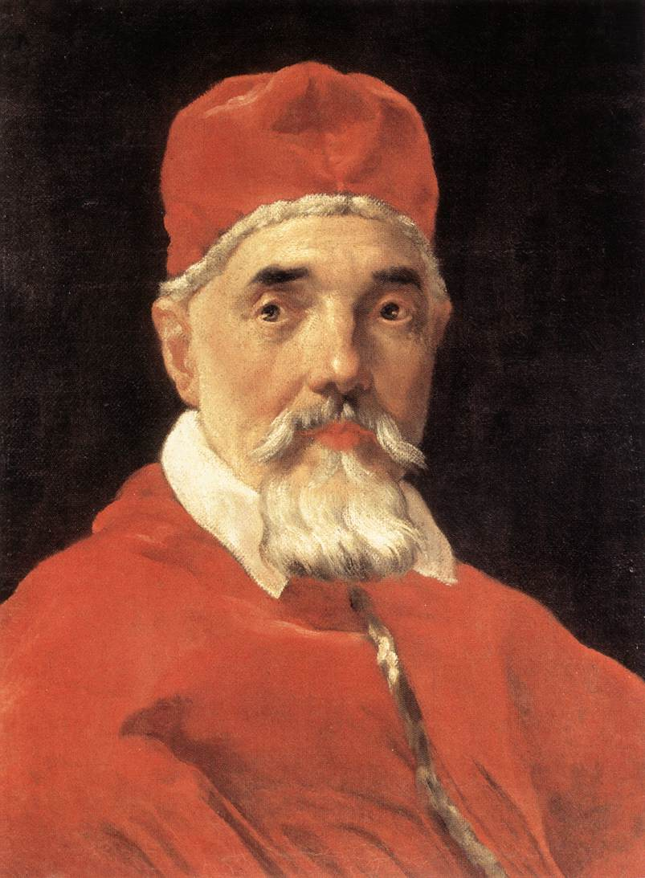
Crusades
P. R. M.
-The Crusades were a set of Holy Wars between Muslims and Christians from 1000-1250 AD.
-Pope Urban II called all Christians to attack and reclaim the Holy Land(Jerusalem) from the Muslims, which was mainly Seljuk Turks. Urban cried out “Deus Vult!” or “God wills it!” in his speech on November 27, 1095
-(OI) However, even though Urban said it was for recapturing the Holy Land, the Pope had other motives. The Byzantine Empire, prior to Urban’s speech, had reached out to him for help because the Turks were threatening to attack them. He hoped that by helping the Byzantines, they would turn to Catholicism(they were Greek Orthodox)and unite all of Europe under him.

Slide 6
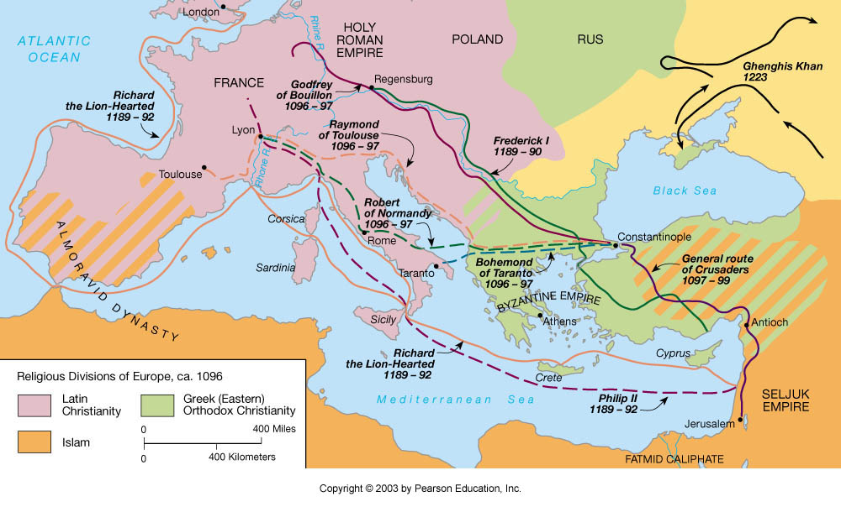
Crusades
P. R. M
-There were a total of 10 crusades, however many people do not include the Children’s Crusade(It would be in between the 4th and 5th Crusade) which was lead by Stephan of Cloyes.
-The Children’s Crusade never reached the Holy Land, as Stephan and his 15,000 followers were tricked, captured, and sold into slavery.
-The most famous Crusade was the Third Crusade, which is also called the Kings Crusade. The most famous leaders from both sides, King Richard the Lionheart(Crusaders), and Saladin(Muslims) took place in this battle, however the two never fought, as the Third Crusade ended with the two taking a truce. This meant that the Crusaders controlled the area surrounding the Holy Land, but failed to capture Jerusalem itself.
-(OI) In the Fourth Crusade, The Crusaders did not attack Jerusalem, but decided to attack the Byzantine capital of Constantinople instead. The Fourth Crusade ended in the Crusaders looting the fabled capital.

Slide 7
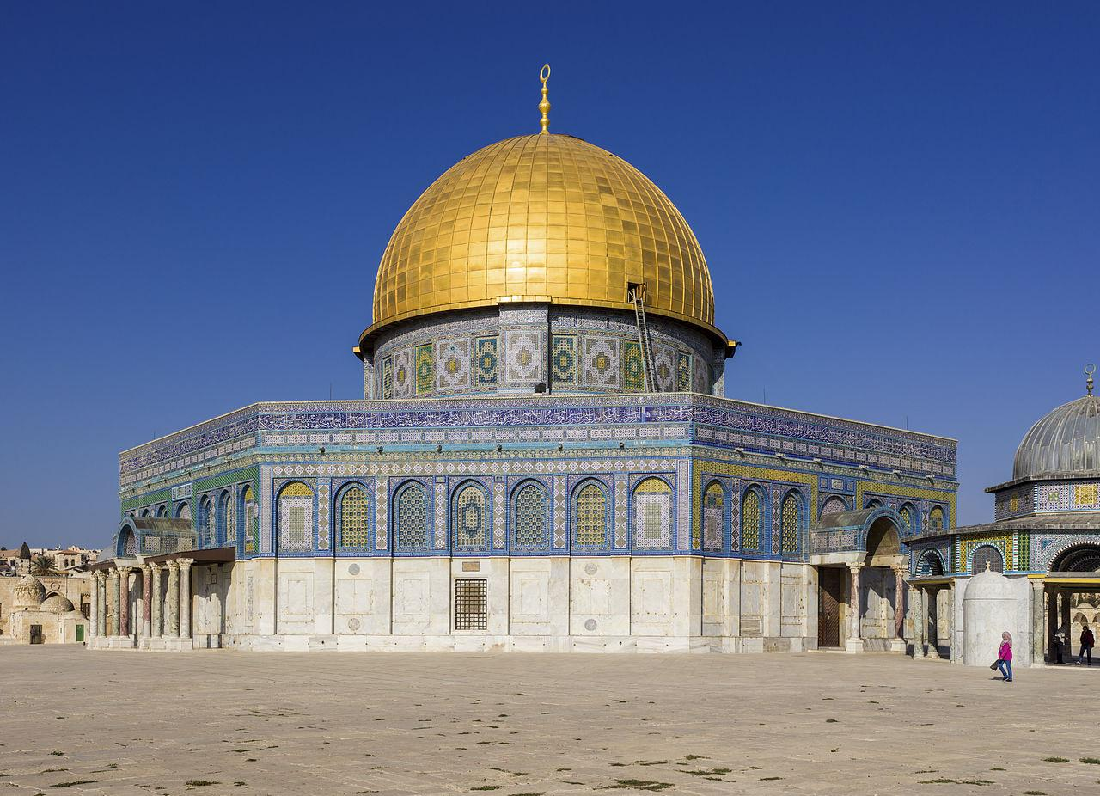
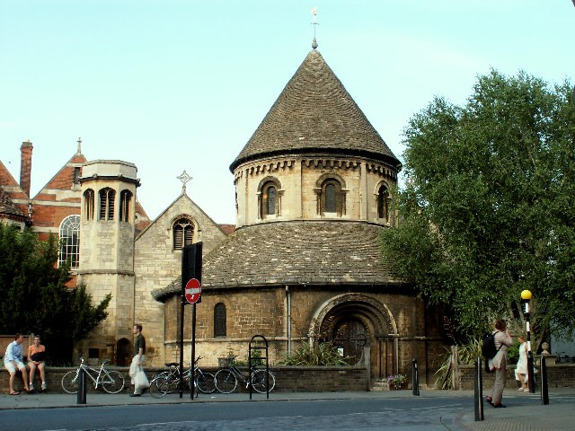
Crusades (Historical Significance)
P. R. M
The Historical Significance of the Crusades is several things, but the main one is that it ended the 1000 year Feudal System. Ironically, the Crusades were meant to expand the Pope’s power, but it actually ended it.(OI) Also, because of this, the trade routes that were monopolised by the Islamic, were now being used by the West.

Slide 8
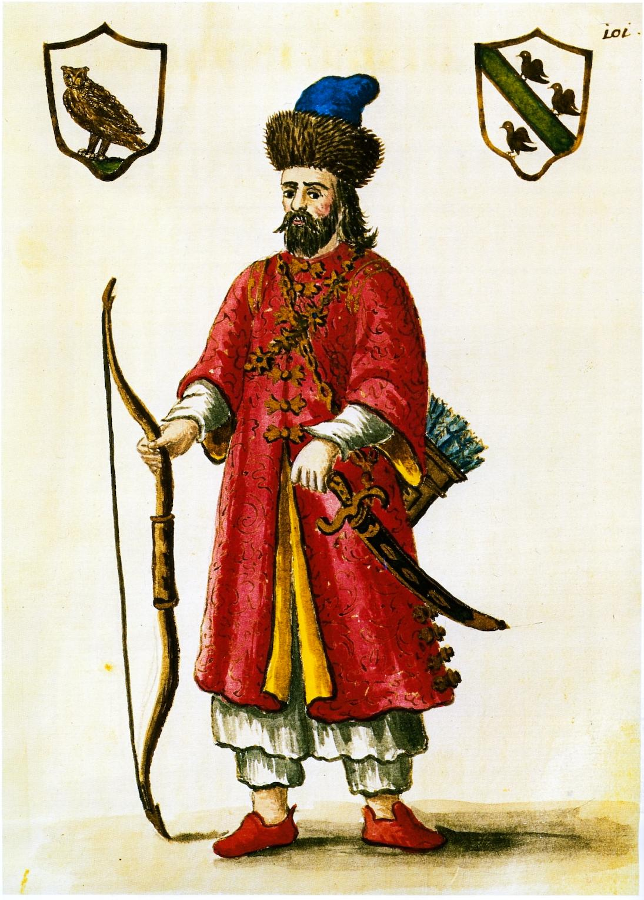
Marco Polo
E. I.
-Marco Polo(1254-1324) was the son of a merchant, and at the age of 17, he left for China with his Father and Uncle in 1275.
- It took Polo, his father, and his uncle 3 years to make it to China, where they meet Kublai Khan(Grandson of Genghis Khan), the Emperor of China.
- (OI) Not only was it just Marco Polo serving Kublai, but his father and uncle stayed there with him for the 17 years he was there.

Slide 9
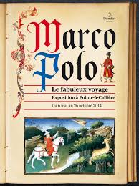
Marco Polo
E. I.
-During Marco’s 17 years in China, him and Kublai establish a deep bond, and Khan escorts him all around China, which at the time was about 5 times the size it is now.
-His trip home from China(to Venice) took 6 years, as Marco went by sea around Asia through the Strait of Malacca, around Africa, through modern-day Iran, into Constantinople(to drop off a princess), back down through the Mediterranean, then into Venice.
-Marco Polo, when he came home to Venice, entered into the war between Venice and Genoa. During that time, he was captured and put into prison, where he met a writer who wrote down of his journey (The Travels of Marco Polo).

Slide 10
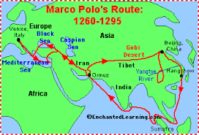
Marco Polo (Historical Significance)
E.I.
The Historical Significance of Marco Polo is he sparked the want for trade with the East. Polo brought back on his journey silk, cinnamon, jade, (OI) and also the idea of a paper currency. More importantly though, he brought the information that China could be reached by water. This led to the countries in Europe trying to find there way to China first, which inspired many future explorers.

Slide 11
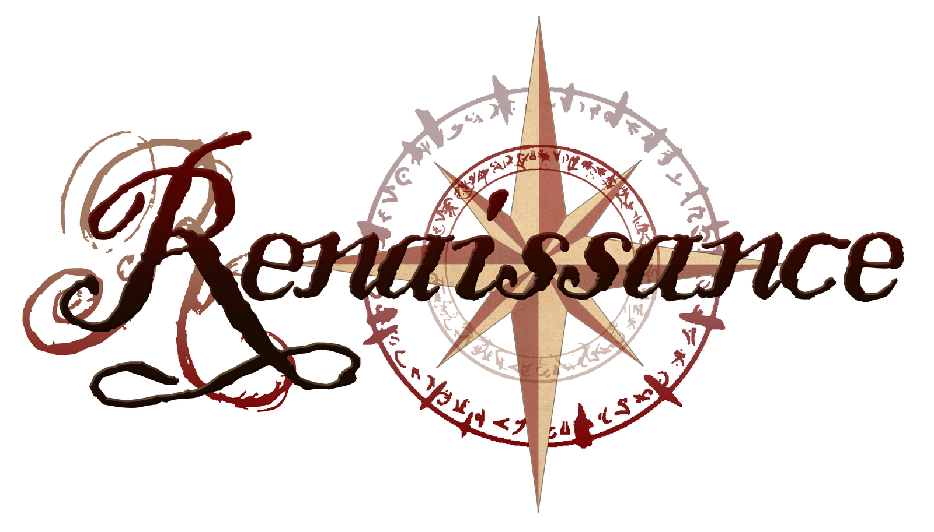
Renaissance
P.E.S.I.A.
-The Renaissance started in 1300 AD and lasted till 1600 AD.
-It started in Florence, Italy with the Medici Family and then spread to Europe.
-(OI) The Medici Family were not the official kings of Italy, however they were the most influential political family in Italy.
-It is nicknamed “The Age of Enlightenment” because during this time, people finally began questioning their life around them and making advancements in science and mathematics.

Slide 12
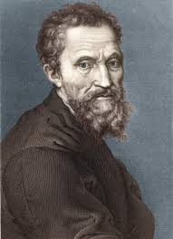
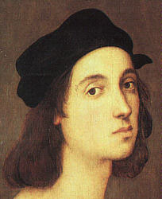
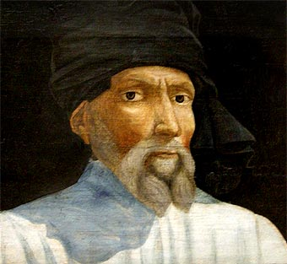
Renaissance (Artists)
E.S.I.A.
Raphael Sanzio 1483-1520
-He was a great Italian artist, and is considered one of the three master painters (Michelangelo & Leonardo are the others)
-He painted the Liberation of Saint Peter & the School of Athens
-(OI) However, even though Raphael is a famous artist now, outside of Rome during the Renaissance, he was known for his printmaking, which is making art by printing, not painting.
Donatello(Donato di Niccolo di Betto Bardi) 1386-1466
-Is not considered a great artist of the Renaissance because he just sculpted.
-His most famous statue is The Statue of David was was made in 1430.
-(OI) Donatello’s first job was a goldsmith, where him and his mentor, Filippo Brunelleschi, gained reputation as treasure-hunters
Michelangelo 1475-1564
-One of the three great artists of the Renaissance.
- Most famous Paintings are The Creation which is one of the “frescos” on the ceiling of The Sistine Chapel, and The Last Judgement on the chapel’s altar wall.
-(OI) When he was 6, Michelangelo's mother died of prolonged illness.

Slide 13
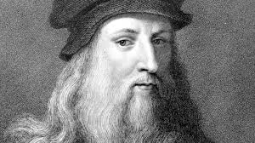
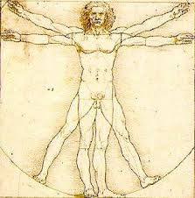
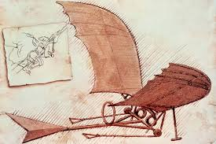
Renaissance (Leonardo Da Vinci)
E.S.I.A.
-Leonardo Da Vinci(1452-1519) is considered the best mind in all of the Renaissance. Not only was he a masterful painter, he was a great scientific mind as well.
-(OI) Also, he is considered the father of paleontology.
-Some of his works include Mona Lisa, The Last Supper, and The Vitruvian Man. The Vitruvian Man is especially important because it was one of the first observations of the human body.
-Because of the Catholic Church’s law on the burial of bodies, Leonardo and his servants would have to steal bodies at night in order for him to learn more about them.
-Da Vinci also had sketches of a flying machine. However, he never learned how to get it off the ground.

Slide 14
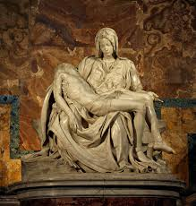
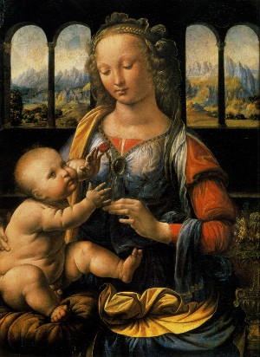
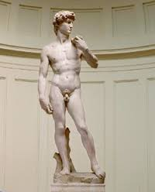
Renaissance (Art)
E.S.I.A.
La Pieta
It was sculpted by Michelangelo, it shows Mary holding Jesus after he is brought down from his cross after he died from the crucifixion.
Madonna of the Carnation
Painted by Da Vinci made in 1472.This is just one of the several “Madonna” paintings made by artists like Da vinci, Michelangelo, etc.
Statue of David
Sculpted by Donatello in 1501-1504. (OI) It actually was placed on a rooftop, it was later moved into a public square for protection from damage.

Slide 15
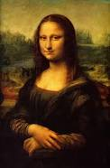
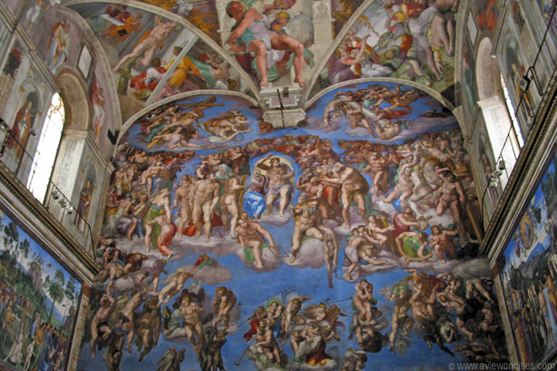
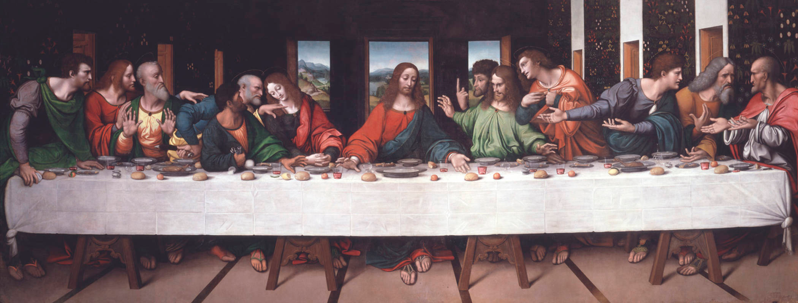
Renaissance (Art)
E.S.I.A.
Last Supper
Painted by Da Vinci in the late 1490’s, which depicts Jesus’s last supper with his disciples before his crucifixion. (OI) This picture is what sparks the famous “Da Vinci Code” Conspiracy.
Mona Lisa
painted by Da Vinci in 1503-1506. However, there are some reports that he continued painting till 1517. this painting is supposed to be about the wife of Francesco del Giocondo.
Sistine Chapel frescos
Last Judgement(Top) and The Creation (Bottom) were both painted by Michelangelo on the wall and ceiling of the Sistine Chapel, respectively.

Slide 16
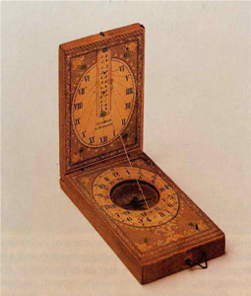
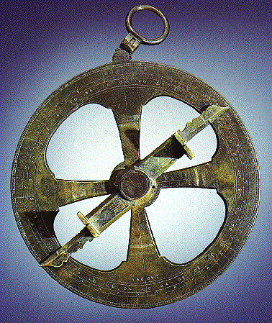
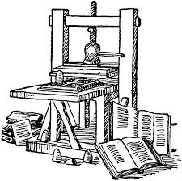
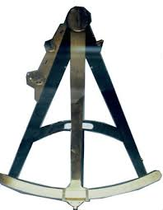
Renaissance (Inventions)
E.S.I.A.
-There were 4 major navigational inventions that were made in the Renaissance.
-The compass was one of them, (OI) the compass actually was being used in China in the 200’s, but it never came to europe till the 1300’s. A red needle, using the Earth’s magnetic pull, always pointed north.
- The Astrolabe was another. Even though the Astrolabe was not an invention itself, it was the term used to describe any instrument used to measure the altitude above the horizon, which was later used to map out the latitude.
-The Printing Press was another one. The Printing Press was used to mass produce maps, which led to more explorers having them.
-The Sextant was the same as a quadrant(an instrument used to measure the angular separation between stars), except it was much more portable.
-

Slide 17
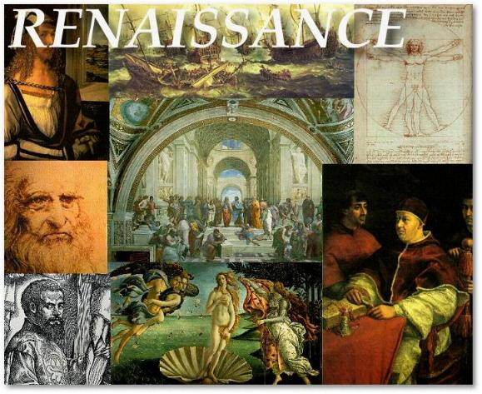
Renaissance (Historical Significance)
P.E.S.I.A.
The Historical Significance of the Renaissance is that it sparked the curiosity of the people to start looking at the unknown.(OI) Also, it took power away from the church, as seen how Da Vinci would take bodies, knowing that is against Catholic Law, so he could do his research on them. Without the Renaissance, there would not be the curiosity or the tools necessary in order for people to explore outside of Europe.

Slide 18
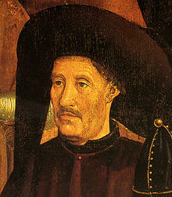
Prince Henry the Navigator
I.
-Prince Henry(1394-1460) was a Portuguese navigation teacher who opened up the Prince Henry School of Navigation in 1419.
-Prince Henry created the caravel, a remarkable ship which was lighter than other ship, and also had the ability to sail windward(toward the wind), to sail to the parts of Africa which contained many different rumors, such as the currents that send you off the Earth, and if you got past that, the boiling waters in the south.
-(OI) Prince Henry the Navigator actually got his nickname from two German historians: Hienrich Schaefer and Gustav de Veer.

Slide 19
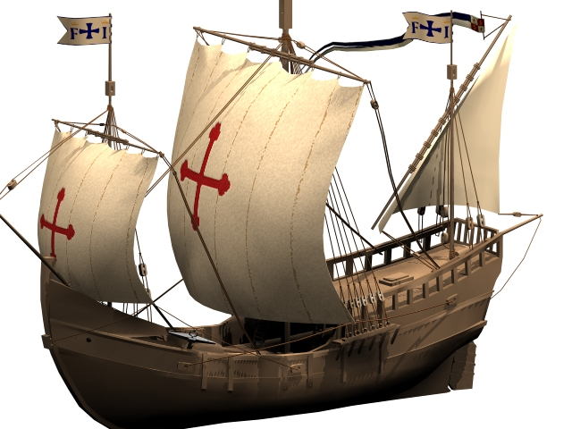
Prince Henry the Navigator (HS)
I.
The Historical Significance of Prince Henry the Navigator is that he sparked the interest of explorers, as well as made it easier to do so, with the caravel,(OI) which was able to do so because of its three-sailed set up. Also, Christopher Columbus was inspired to become an explorer because of Prince Henry, so without him, Columbus would just be a speck in the historical timeline.

Slide 20
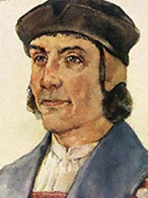
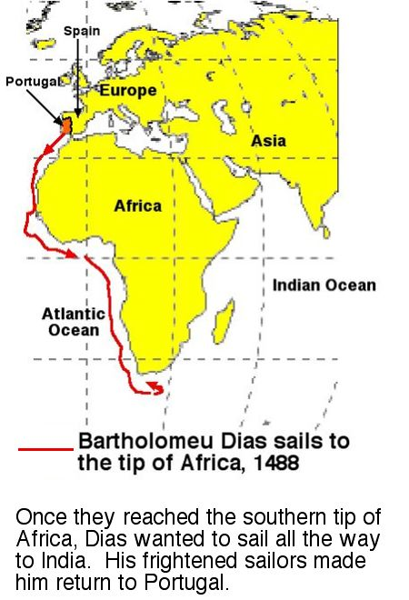
Bartholomeu Dias
I.
-Bartholomeu Dias(1450-1500) was a Portuguese explorer who had attended Prince Henry’s School of Navigation.
-He was the first person who was able to make it to the southern tip of Africa there and back(Oct. 10, 1487- Mar. 12, 1488), proving the rumors of the boiling waters wrong.
-He actually wanted to go to India, however his crew threatened mutiny, so he turned back.
-(OI) After his voyage, he later helped make a ship that was going to go the route he did, however carry on to India.

Slide 21
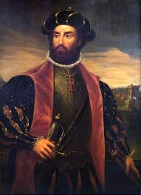
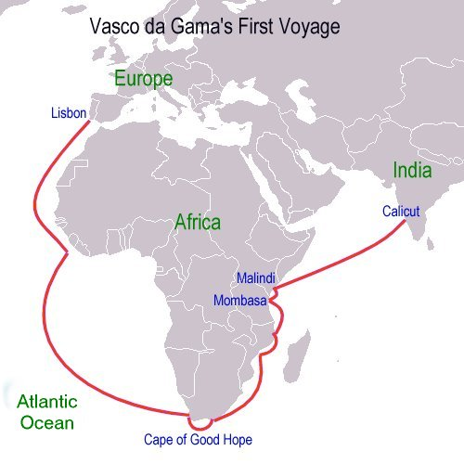
Vasco Da Gama
I.
-Vasco Da Gama(1460-1524), was a portuguese explorer who attended Prince Henry’s School of Navigation.
-He sailed from Portugal to India(July 1497- May 1498), by using Dias’s route to the southern tip, then continued on to India, making it the first time Europe and India linked by sea.
-The Voyage establish Portugal as a world power, as it dominated the spice trade between the East and the West.
-(OI) His route would actually open the door for Portugal Imperialism in Asia.

Slide 22
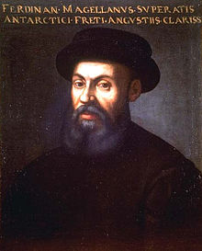
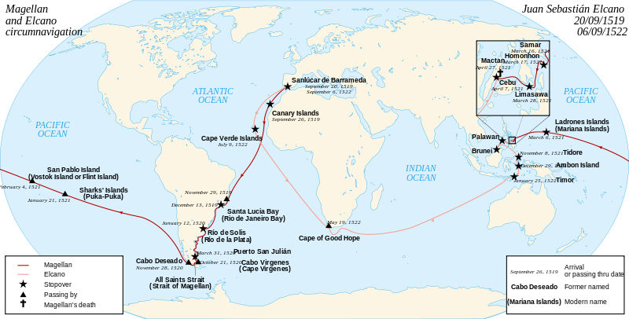
Ferdinand Magellan
I.
-Ferdinand Magellan(1480-1521) was an explorer from Portugal.
-He wanted to reach the Indonesian Spice Islands, but only knew De Gama’s route.(bottom left is the map)
-He died in the philippines, but his crew were the first to circumnavigate the world!
-(OI) Only 18 of the original 237 men were able to make it back alive from this journey.

Slide 23
Early Explorers HS
The Historical Significance of these 3 early explorers is that they were able to dispel any myths about sailing around Africa, and that they were finally able to connect East Asia to Europe. (OI)Also, because 2 out of the 3 explorers sailed for Portugal (Ferdinand sailed for Spain), it established Portugal as a world power, and made other countries such as France, Spain, etc, want to be a part of this trade.

Slide 24
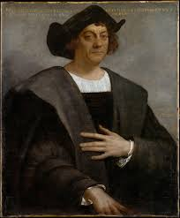
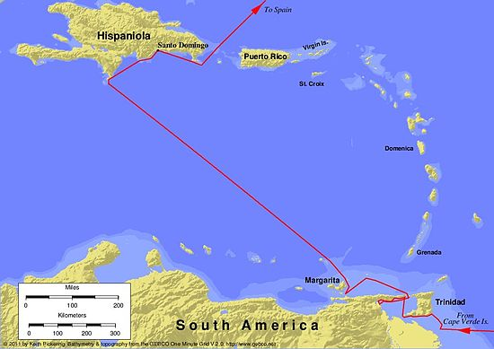
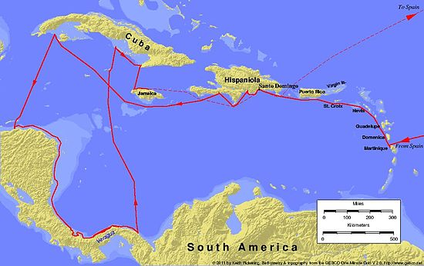
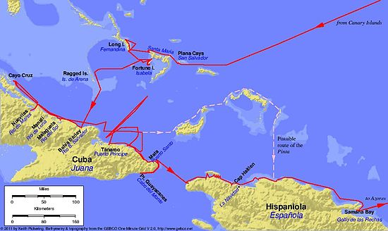
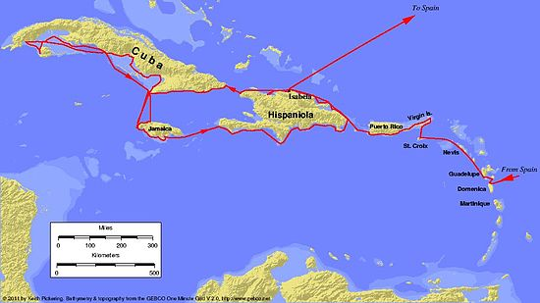
Christopher Columbus
E.
-Christopher Columbus (1450-1506) was an Italian explorer that sailed for Spain and accidently discovered the new world in Sept. 1492.
-Christopher Columbus was one of the few people of the day who thought the earth was round, and that you could reach Asia from Europe if you just sailed west.
-He sailed for 5 weeks with 3 main ships, one regular ship, the Santa Maria, and two caravels, the Pinta and Santa Clara.
-He landed in the Bahamas (he called it San Salvador) first, and thinking he was in the Indies, he called all of the inhabitants Indians.
- He actually would make 4 trips to the new world, exploring the islands of Cuba, Hispaniola(Dominican Republic/Haiti), and parts of northern South America and southern Central America.
-(OI) He is responsible for the Columbian exchange, as he brought home slaves on all 4 of his trips

Slide 25
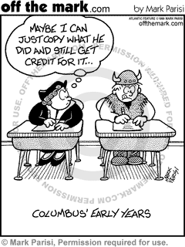
Christopher Columbus HS
The Historical Significance of Christopher Columbus is that he discovered the New World, leading the way for Imperialism throughout Europe in the Western Hemisphere.(OI) Also, because Spain was the first to discover this land, they claimed it for themselves, and became a world power to rival Portugal.

