Slide 1
Student Rights and Responsibilities
Deer Valley High School
2016-2017
“A Responsibility is an obligation one has to ensure that the RIGHTS of all are protected.”

Slide 2
Student Rights and Responsibilities Handbook
Where to find both handbooks
On-line link to SRR Handbook

Slide 3
What is the most important thing you can ever have?
Notes:
Image of Word Map is HYPERLINK- https://www.youtube.com/watch?v=Lg-wNxJ5XxY
YouTube- What Matters Most in Life? -PragerU 5:27

Slide 4
What kind of school do you want?
Are the teachers and staff caring? Do they help you learn?
Are the other students respectful? Are they welcoming and kind?
Are spirit events fun and exciting?
Is the campus clean and safe?
Do we have access to resources?
We depend on each other to make our school great!
This is just an empty building until YOU get here!

Slide 5
The Values of Deer Valley

Slide 6
Accountability
Be accountable for your actions as young adults
Own up to your actions, and accept the results—whether they be consequences or privileges.
Be in the location you are supposed to be.
Use passing time wisely
We are responsible for your safety and in an emergency we need to know where to find you.
If you need to use the restroom or the nurse, ask for a pass from your teacher. Security may ask to see this pass and your ID at any time.
Dress appropriately for a Workplace
Please remember that this is a school and workplace. We want everyone to feel safe, and to remember why they are here, which is to learn.
Be accountable for your technology use.
When you are participating in a conversation or activity with others, put down your phone. It is disrespectful and bad-mannered to be on your electronic device when someone is trying to help you.
Use headphones when listening to personal music. Playing your music on speakers will result in confiscation.
Notes:
Dress Code
Any attire that detracts from the learning environment is not acceptable. Students should dress in a manner that, in addition to the following guidelines, takes into consideration the educational environment, safety, health and welfare of self and others.
• Clothing must cover the entire buttocks. Shirts and tops may not expose bare midriffs, bare shoulders, nor be deeply or narrowly cut in the front, back, or under the arms. Halter tops, spaghetti straps, and strapless tops are not acceptable. Clothing that exposes undergarments will not be tolerated for males or females.
• Bare feet are never acceptable. In the interest of safety, shoes must be worn at all times. Closed shoes are to be worn for any type of physical activity, such as physical education, cheer practice, weight lifting, etc.
• Jewelry or ornamentation shall not be worn if it presents a safety hazard to self and/or others.
• No hats may be worn inside any campus buildings at anytime, except for properly approved occupational safety headgear required for special classes.
• Defamatory writing, obscene language or symbols, or symbols of drugs, sex, or alcohol on clothing or jewelry are expressly prohibited.
• Tattoos displaying defamatory writing, obscene language or symbols, or symbols of drugs, sex, or alcohol must be covered.

Slide 7
Integrity
Report safety concerns immediately!
If you see someone or something suspicious, report it to a staff member immediately!
DV SILENT WITNESS- 623-376-3262 (PUT IN YOUR PHONE!)
Be honest and kind
If you want a school without drama, hatred, or bigotry, don’t bring it here. Instead bring positivity, honor, and strength to persevere through differences.
Stand up for others
Make a difference in the lives of others by being a hero. It only takes a moment, but the impact lasts a lifetime. Don’t let this be a campus where bullying and harassment run rampant.
Work hard in your classes.
Ask for help before the last minute
Your teachers put in a lot of work to help you learn and advance to the next level of YOUR educational career. Make it worth their while, and yours.
Average weekly income w/o H.S. Diploma: $451
Average weekly income w/ H.S. Diploma: $638 -U.S. Bureau of Labor Statistics
Notes:
Consider telling students they can take out their phones and program the silent witness number into it!

Slide 8
Respect
Treat staff and students with respect
Do not use offensive language. It makes everybody feel unsafe and on edge.
Respect the requests of staff and security personnel. They are acting in the interests of safety, even though it may not seem that way to you.
Respect our school, and try to keep our resources in good condition.
Don’t bring food and drink into the buildings; it would ruin our carpet and stink up our hallways.
Don’t ride or skate on campus. We could be held liable for your face-plant. Bikes can be locked up in the bike rack, as well as skateboards. Be careful and gentle with our technology. It has to last for a long time to come. You know how little funding schools get to replace damaged property.
Report vandalism to staff or DV Silent Witness immediately. It’s YOUR school. Take pride in it.
Respect yourself enough to stay true to your values. Don’t let your friends peer-pressure you into doing something you don’t feel is right.

Slide 9
Technology
Many students want to have the privilege of carrying electronic devices on campus. With that privilege comes the responsibilities of ensuring that those items are not used inappropriately or at inappropriate times on campus or on a bus.
Unauthorized access, unauthorized or improper use of hardware or software, tampering/vandalism will result in discplinary procedures!
Online Harassment/Bullying:
Harassment Legal Definition: the act of systematic and/or continued unwanted and annoying actions of one party or a group, including threats and demands
Camera-Use: Taking pictures or videos of others without their consent is selfish, rude and uncalled for. Do not harass others this way.
Sexting: Texting partially nude or nude photographs of minors is considered Distribution of Child Pornography and a serious crime. Not only will it cause consequences on your social life, but depending on what you do with lewd photos, you can face jail time in Arizona.
DVUSD is not responsible for lost or stolen property! Be accountable for yours!

Slide 10
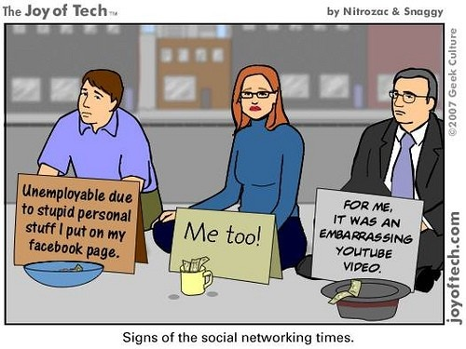
Social Media
Many students use social media. It is great for connecting to the people you care about.
However, many students misuse it. Be aware that:
You can get around privacy walls. If it’s there, it’s accessible to anyone who really wants it.
You can’t delete it. It will always be available.
Colleges AND employers are checking your digital footprint when you apply.
Bullying, derogatory comments to specific races, religions or genders, drug and alcohol use, etc.

Slide 11
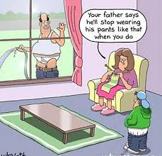
Dress Code
Dress with Integrity, and remember this is a workplace, please.
Imagine how awkward it is for staff to tell a student that:
Your shirt is demeaning, and suggests that you are a terrible person.
Your breasts are falling out of your shirt
I can see your underwear
Girls- Straps should be two fingers thick. Please cover buttocks.
Boys- Pants should cover underwear. Refrain from wearing offensive shirts (drug/alcohol references, nudity, violence)

Slide 12
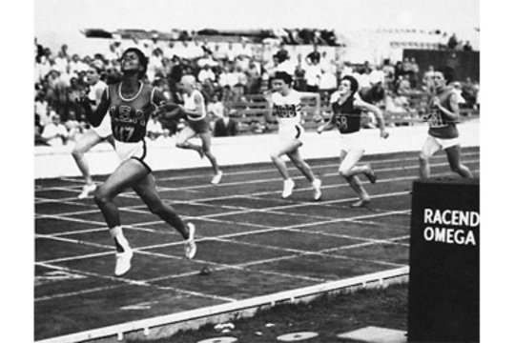
No Pass = No Play
We expect AIR qualities, especially in our athletes. Be a leader, not a problem.
If you participating in Athletics or Activities here on campus, you must keep your grades above 60% at the risk of being labeled “ineligible” for the week’s games or competitions.
This means you will not be able to play or perform until you are passing ALL classes.
Win with HONOR!
Notes:
EXTRA-Curricular activities are considered EXTRA to the curriculum, not in place of it. Students are still expected to fulfill all duties as a student before competing or participating in extra-curricular activities.

Slide 13
Other Specifics
You are not allowed to carry any medication on campus
Medication must be brought in by guardians and left with the Nurse. It is then available to you to take when needed.
Schedule Changes can only be made only to fulfill graduation requirements (ex. you already took the class, are replacing an elective, etc.) , not because you want a different teacher, classmates, or lunch.
Graduation Requirements for AZ can be found in the Handbook.
Absences and Tardies:
If you are late to campus, you must have a parent or registered guardian sign you in at the front office.
LIMIT 5 TIMES PER SEMESTER. THEN YOU ARE TRUANT
If you are late to your next class, you will report to the SWEEP room (rm 624).
Excessive absences may result in disciplinary consequences

Slide 14
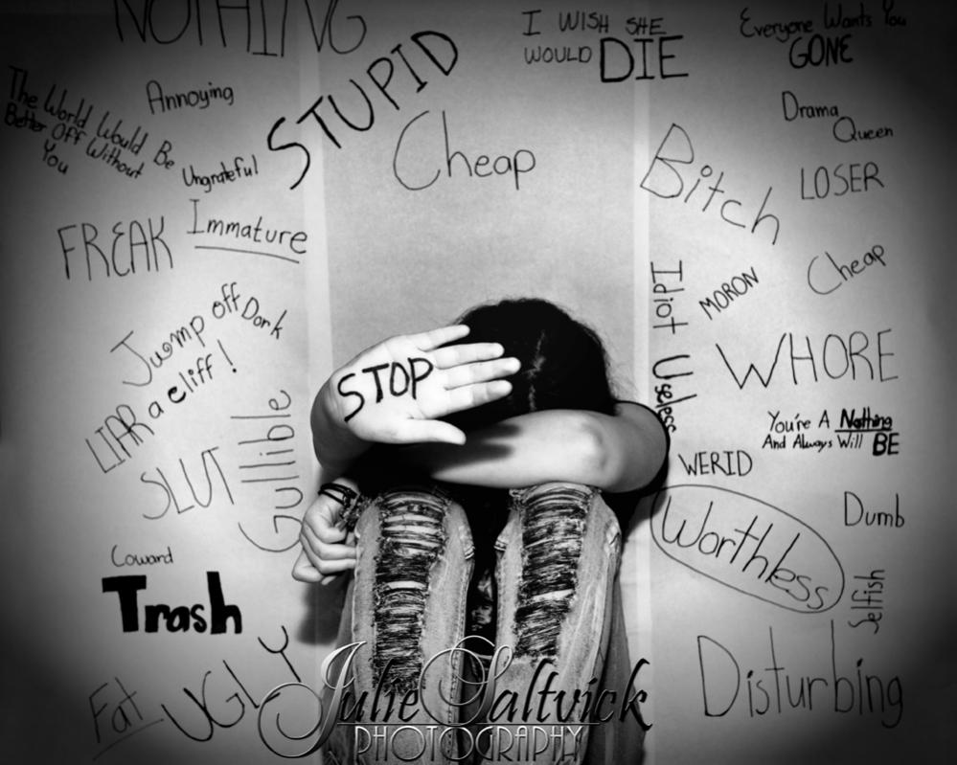
To Report Bullying/Harassment
Pick up an Incident Form or Bullying Report Form in Ms. Roberts office, in the Administration building.
Fill out and submit and it will be dealt with as soon as possible.
Any staff member can help you.
Notes:
Bullying: Bullying may occur when a student or group of students engages in any form of behavior that includes such acts as intimidation and/or harassment that:
• has the effect of physically harming a student, damaging a student’s property, or placing a student in reasonable fear of harm or damage to property,
• is sufficiently severe, persistent or pervasive that the action, behavior, or threat creates an intimidating, threatening, or abusive environment,
• occurs when there is a real or perceived imbalance of power or strength, or
• may constitute a violation of law.
Bullying of a student or group of students can be manifested through written, verbal, physical, or emotional means and may occur in a variety of forms including, but not limited to:
• verbal, written/printed or graphic exposure to derogatory comments, extortion, exploitation, name calling, or rumor spreading either directly, through another person or group, or through cyberbullying;
• exposure to social exclusion or ostracism,
• physical contact including but not limited to pushing, hitting, kicking, shoving, or spitting, and
• damage to or theft of personal property.
Cyberbullying: Cyberbullying is, but not limited to, any act of bullying committed by use of electronic technology or electronic communication devices, including telephonic devices, social networking and other internet communications, on school computers, networks, forums and mailing list, or other District-owned property, and by means of an individual’s personal electronic media and equipment.
Harassment: Harassment is intentional behavior by a student or group of students that is disturbing or threatening to another student or group of students. Intentional behaviors that characterize harassment include, but are not limited to, stalking, hazing, social exclusion, name calling, unwanted physical contact and unwelcome verbal or written comments, photographs and graphics. Harassment may be related, but not limited to, race, religious orientation, sexual preference, cultural background, economic status, size or personal appearance. Harassing behaviors can be direct or indirect and by use of social media.

Slide 15
Definition of Harassment
The act of systematic and/or continued unwelcome or annoying actions of one party or group, including threats and demands.
The purposes may vary, including racial prejudice, personal cruelty, an attempt to force someone to behave in a certain way (quit a club, team, or class) or grant sexual favors.
If it is UNWANTED, it is HARASSMENT
If they tell you to stop or leave him or her alone, and you do not, it is HARASSMENT.

Slide 16
Bullying Defined
Bullying is unwanted, aggressive behavior that involves a real or perceived imbalance of power. The behavior is repeated, or has the potential to be repeated, over time. Both kids who bully and are bulled may have serious, lasting problems.
Cyberbullying IS bullying! And it is easier to prosecute because it is easily traceable!

Slide 17
Bullying
The student should…
Tell what happened in response to the event
Tell who bullied and who witnessed the bullying
Tell where the incident happened and how it happened
Write down everything that occurred
Get help from a person in authority, such as a teacher or counselor
See the school nurse if the bullying or threat is physical in nature
Bullying of a student or a group of students can be manifested through written, verbal, physical, or emotional means and may occur in a variety of forms including, but not limited to:
Verbal, written/printed or graphic exposure to derogatory comments, extortion, exploitation, name calling or rumor spreading, either directly, through another person or group, or through cyberbullying
Exposure to social exclusion or ostracism
Leaving someone out of the group, or kicking him/her “out”
Physical contact including but not limited to pushing, hitting, kicking, shoving, or spitting, and
Damage to or theft of personal property

Slide 18
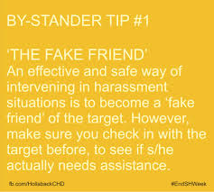
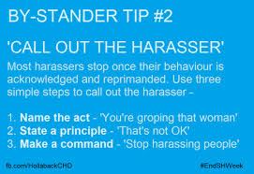
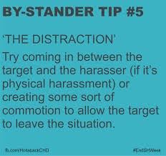
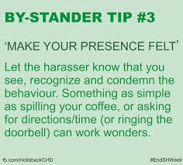

Slide 19
Discipline/Consequences
There is an important matrix inside of the Students Rights and Responsibilities Guide that we must look at.
Page 52
For each violation of school rules, there is a specific consequence.
Serious consequences can occur immediately depending on the violation, and include:
Suspension on or off campus
Expulsion from our school
Notes:
THE QUOTE IMAGE IS A HYPERLINK TO THE STUDENTS RIGHTS AND RESPONSIBILITIES DOCUMENT. PLEASE OPEN AND SHOW TO STUDENTS!
Most serious violations include (other than obvious stuff like armed robbery, homicide and rape):
-Assault
-Drug and Alcohol Violations
-Firearms

Slide 20
Other Topics in the Handbook To Cover
4 Grades, make up work
6 Schedule changes
6 Graduation requirements
8 Athletic eligibility
11 Athlete attendance on game days
12 Student attendance
13 Sweep and disciplinary action
13 Parental tardy excuse
14 Student check out
14 Bicycles, skateboards
15 Cafeteria
15 Closed campus
19 Student ID cards
19 Student parking
21 Medicine on campus
22 How to see the nurse
24 A.I.R.
25 Electronic devices
27 Bus discipline
22 How to see the nurse
24 A.I.R.
25 Electronic devices
27 Bus discipline
Notes:
Teachers, Feel free to cover the content incorporating whatever instructional strategy you prefer with the time allotted. All of the material is important, the above noted sections are critical. Thank you!

Slide 21
AIR Cards
When staff see you being awesome, we want to reward you!
If you receive an AIR card, drop it off in the Media Center desk. There is a special bowl for them.
On Wednesdays we will have drawings for prizes, such as…
Front-of-the-lunch-line pass
DVHS Homework Pass
Free Meals (Barros, Sardellas, Gelato, Macayos, etc.)
Game Tickets, Dance Tickets, Event Tickets

Slide 22
Quiz
Use your Ipad to access the Students Rights and Responsibilities Handbook on the DVHS website.
Find the answers to each of the questions on your worksheet.
Notes:
Students may use their Ipads to access the school website, and the Students Rights and Responsibilities Handbook under the For Students tab.
The quiz could be more specific questions, forcing the students to go on a mini-scavenger hunt for information. This could be done on the next SET day, as a review of the school policies.
IDEAS FOR TEDTALKS: (WE CAN MAKE THE PICTURE ABOVE A HYPERLINK)
I’m 17- https://www.youtube.com/watch?v=0OkOQhXhsIE&list=WL&index=1
What Adults Can Learn From Children: http://www.dvusd.org/cms/lib011/AZ01901092/Centricity/Domain/42/16-17%20Students%20Rights%20and%20Responsibilities%20English.pdf

