Slide 1
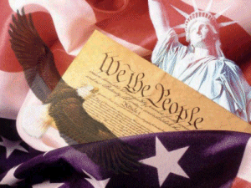
United States Constitution 101
Constitution 101:
An Introduction & Overview to the US Constitution

Slide 2
The Articles of Confederation
America’s 1st Constitution 1781-1789
Why did the Founding Fathers Choose a Confederation plan of government?
Why Did the Founding Fathers believe the Articles needed to be replaced by the US Constitution?
Strengths
Weaknesses
The first system of government designed by the Founding Fathers was a Confederation. Under a Confederate system, the National or Central Government is given only a few powers, while most of the power is reserved for the States.

Slide 3
The Articles of Confederation
America’s 1st Constitution 1781-1789
The Articles had 2 major achievements:
Bringing the Revolutionary War to a successful conclusion
North West Ordinance (plan for governing the western lands)

Slide 4
The Articles of Confederation
America’s 1st Constitution 1781-1789
Strengths
Weaknesses
Congress was given the power to:
Declare War &
Establish an Army/Navy
No Power to Draft Soldiers

Slide 5
The Articles of Confederation
America’s 1st Constitution 1781-1789
Strengths
Weaknesses
Congress was given the power to:
Make Peace & Sign Treaties
No Power to Enforce Treaties

Slide 6
The Articles of Confederation
America’s 1st Constitution 1781-1789
Strengths
Weaknesses
Congress was given the power to:
Borrow Money
No Power to Collect Taxes from the States

Slide 7
The Articles of Confederation
America’s 1st Constitution 1781-1789
Strengths
Weaknesses
Congress was given the power to:
Organize a
Post Office

Slide 8
The Articles of Confederation
America’s 1st Constitution 1781-1789
Strengths
Weaknesses
Congress was given the power to:
No Chief Executive
No national court system
No Power to Regulate Interstate Commerce
No National Currency
Difficult to Pass laws (2/3 vote)

Slide 9
The Articles of Confederation
America’s 1st Constitution 1781-1789
Strengths
Weaknesses
Congress was given the power to:
Difficult to Amend
(unanimous vote needed to change the articles)

Slide 10
The Articles of Confederation
Congress given the power to:
Declare War
Make Peace
Sign Treaties
Borrow Money
Establish an Army & Navy
Organize a Post Office
No Chief Executive
No National Court System
No Power to Draft Soldiers
No Power to Control Interstate Commerce
No Power to Enforce Treaties
No Power to Collect Taxes from the States
Difficult to Pass Laws (2/3 vote)
No National Currency
Difficult to Amend
(Unanimous Vote Needed to Change Articles)

Slide 11
Conclusion
Why did the Founding Fathers Choose a Confederation plan of government?
They feared that a strong central government would create tyranny, and stamp out the peoples natural God given rights.

Slide 12
Conclusion
Why Did the Founding Fathers believe the Articles needed to be replaced by the US Constitution?
The nation needed to function as ONE united country & not 13 small unorganized nations.
Shay’s rebellion proved the need to strengthen the government.

Slide 13
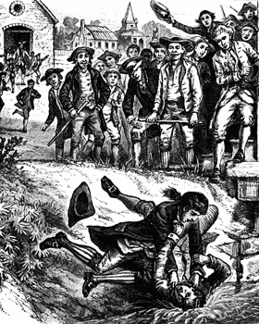
Shay’s Rebellion forced gov’t to realize they needed a stronger gov’t
Shays’ Rebellion:
  An uprising of farmers in Massachusetts – led by Daniel Shays.
  Helped convince leaders that a strong central government was needed.
"A scene at Springfield, during Shay's Rebellion, when the mob attempted to prevent the holding of the Courts of Justice."—E. Benjamin Andrews, 1895

Slide 14
What is the US Constitution?
The supreme law of the United States.
It is the foundation and source of the legal authority underlying the existence of the United States of America and the Federal Government of the United States.
It provides the framework for the organization of the United States Government.

Slide 15
What are the basic principals of the Constitution?
Popular Sovereignty
  Government power resides in the people
Limited government
  Government is not all powerful, can only do what the people let it.
Separation of Powers
  Helps prevent one branch from becoming too powerful
  Checks and Balances
Federalism
  Division of power among national and state governments

Slide 16
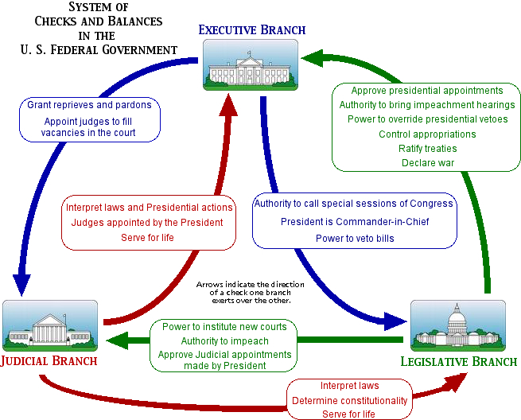
What are the Checks and Balances?

Slide 17
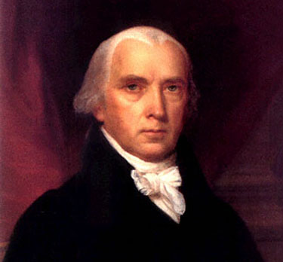
Who Wrote It?
James Madison is considered “the father of the Constitution.”
His important contributions:
  The Virginia Plan
  Separation of Powers
  Bill of Rights

Slide 18
Why was it written?
After the Revolutionary War, the Articles of Confederation set up the structure of the US Government.
The federal government was extremely weak and this created many problems.

Slide 19
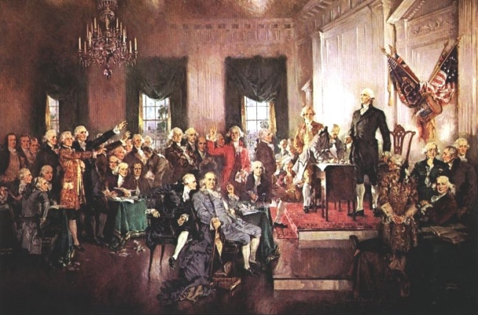
When was it written?
May 25th to September 17th, 1787
Philadelphia
Intention was to revise Articles of Confederation
Ended up replacing the Articles and creating a new government
Called the “Constitutional Convention.”

Slide 20
What were the important outcomes of the Constitutional Convention
Virginia Plan:
  Separation of powers
  Bicameral legislature based on population
  Federal government had increased powers
New Jersey Plan:
  Unicameral legislature where every state received equal representation.
Great Compromise:
  Hybrid of VA and NJ Plans:
    Bicameral legislature:
      House of Reps based on population
      Senate based upon equal representation
  Three-Fifth’s Clause:
    Slaves count as 3/5’s of a person for representation purposes.

Slide 21

Ratification Debate
Needed 9 of 13 states to ratify or official approve of the Constitution before it went into effect.
A huge debate emerged between two sides:
  Federalists
  Anti-Federalists

Slide 22
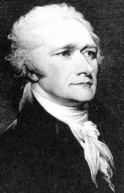
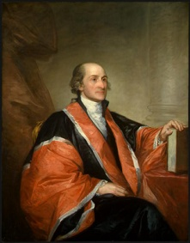
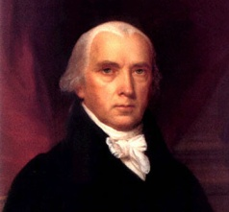
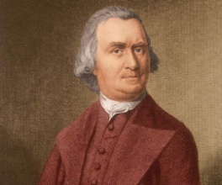
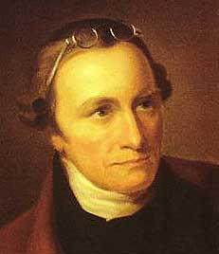
Federalists v. Anti-Federalists
Federalists:
  Supported the Constitution and a strong central government
  Alexander Hamilton, James Madison, John Jay
  Federalist Papers – series of articles written in defense of the Constitution
Anti-Federalists:
  Supported a weaker central government – felt too much power was taken away from the states
  Opposed the Constitution
  Wanted a Bill of Rights included
  Samuel Adams, Patrick Henry

Slide 23
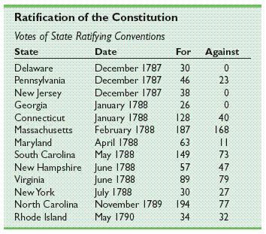
Ratification
Officially adopted after ratified by New Hampshire.
Once the new government convened, they added a Bill of Rights to the Constitution.

Slide 24
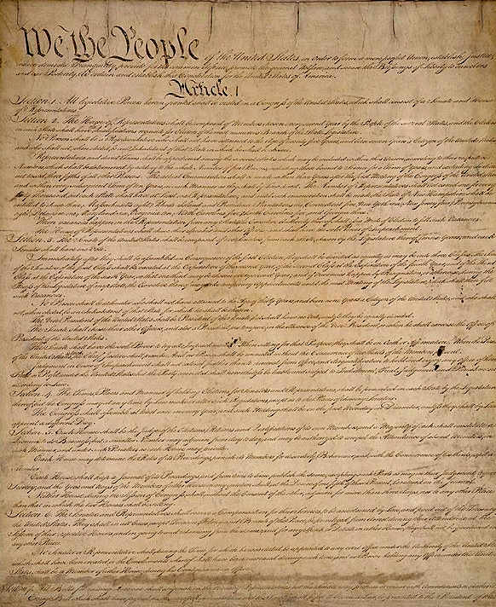
Structure of the Constitution
Preamble:
  Statement of purpose
Articles:
  I: Legislative Branch
  II: Executive Branch
  III: Judicial Branch
  IV: Relations Among the States
  V: Amendment Process
  VI: Federal Power
  VII: Ratification
Amendments:
  27 Total
  1st ten are the Bill of Rights

Slide 25


Article I: Legislative Branch
Bicameral:
  Senate
    2 Senators for each state
  House of Representatives
    Based on population
Reps serve for 2 year terms
Senators serve for 6 year terms
Important Powers:
  Make laws
  Set taxes
  Declare war
  Override Vetoes
  Borrow money
  Regulate international and national trade
  Print money

Slide 26


Article II: Executive Branch
President and Vice President are elected to 4 year terms
Qualifications:
  At least 35 years old
  14 year resident of the US
  Natural born citizen
Elected by the Electoral College
Important powers:
  Commander-in-Chief
  Grant pardons
  Make treaties
  Appoint federal officers
  Ensure laws are executed

Slide 27
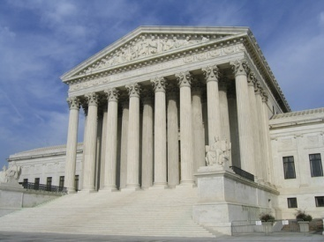

Article III: Judicial Branch
Supreme Court judges serve for life unless impeached.
Judicial power rests with US Supreme Court and other courts created by Congress
Important Powers:
  Decides cases of Constitutional law and federal law
  Cases involving ambassadors go straight to Supreme Court
  Judicial Review comes later (1803 – Marbury v. Madison)

Slide 28

Other Important Articles:
Article V: Amendments:
  Amendments are proposed when 2/3 of House and Senate deem it necessary
  Amendments are proposed when 2/3 of states deem it necessary
  Amendments must be ratified by ¾ of state legislatures or by conventions in ¾ of states
Article VI: Federal Power
  Supremacy Clause: Federal law is supreme to state law
  No religious tests for public office

Slide 29
Important Amendments:
Bill of Rights
Freedom of religion, of speech, of the press, to assemble, and to petition
Right to bear arms
No quartering of soldiers
No unreasonable search and seizure
Indictments; Due process; Self-incrimination; Double jeopardy, and rules for Eminent Domain.
Right to a fair and speedy public trial, Notice of accusations, Confronting one's accuser, Subpoenas, Right to counsel
Right to trial by jury in civil cases
No excessive bail & fines or cruel & unusual punishment
There are other rights not written in the Constitution
All rights not given to Federal Government belong to states and people.

Slide 30
Other Important Amendments:
Reconstruction Amendments
13th Amendment
  abolished slavery
14th Amendment
  Due process and equal protection under the law
  All persons born in US are citizens
15th Amendment
  Right to vote regardless of race, color, or previous servitude
  Known as the “Civil War Amendments”
  Later renamed the “Civil Rights Amendments”

Slide 31
Other Important Amendments:
18th Amendment
  Prohibition of alcohol
19th Amendment:
  Women’s suffrage
21st Amendment:
  Repeals prohibition
22nd Amendment:
  Presidential term limits
24th Amendment:
  Prohibits poll taxes for voting
26th Amendment:
  lowers voting age to 18

